Slide 1
Software Engineering Concepts (CSC205)
Lecture 7

Slide 2
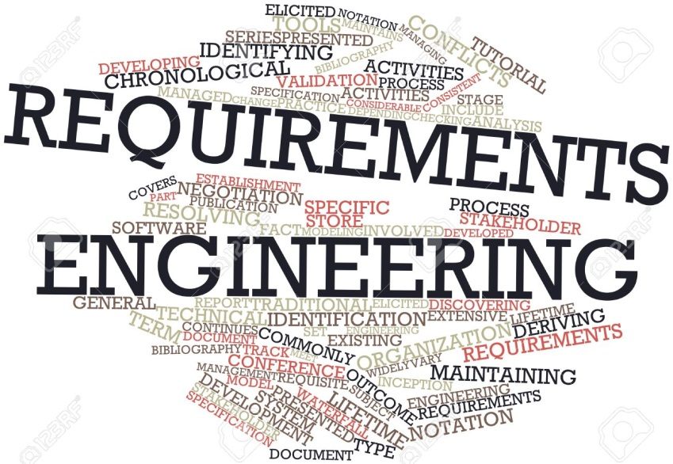
Topics
Requirement Engineering
Introduction
Type of Requirements
Functional vs. Non-Functional Requirements

Slide 3
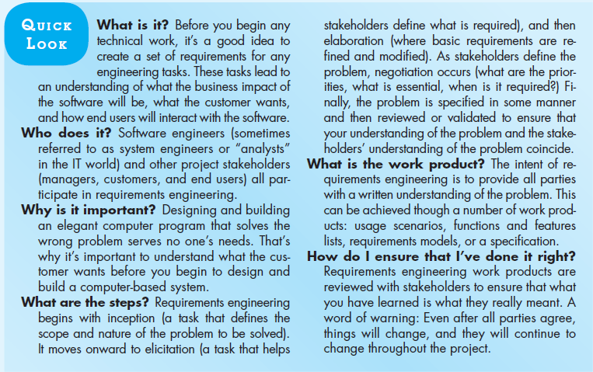

Slide 4
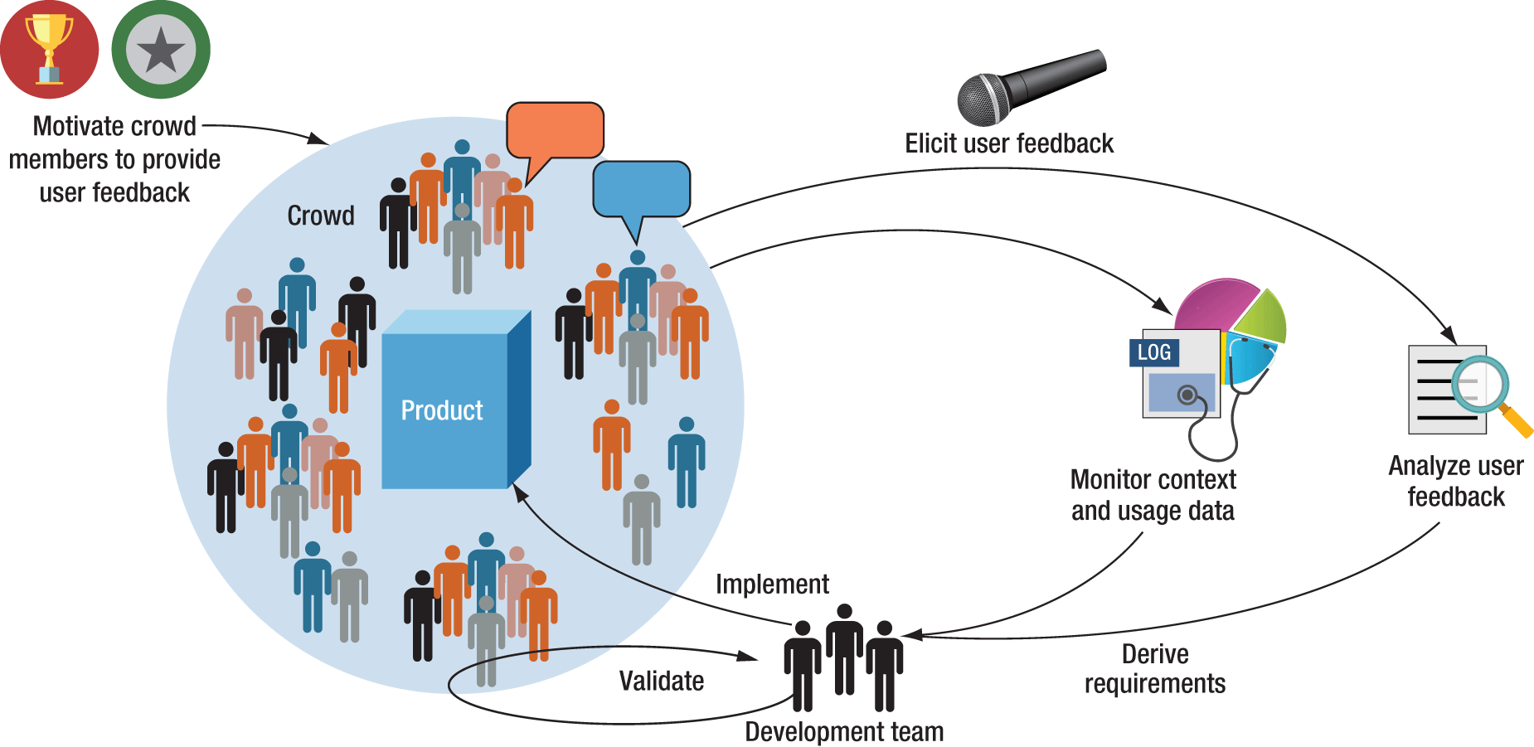
Requirements Engineering (RE): Introduction
The hardest single part of building a S/W system is deciding “What to Build”. No part of the work so cripples the resulting system if done wrong. No other part is difficult to rectify later.” [Fred Brooks]
In reality the change of Req’s is one of the main cause of project slippage and cost overruns
“Incomplete Req’s” or “Changing User req’s”
The failure of
FAA
CONFIRM
The Field System of the Dept of Employment, UK
The Chart (II) Project, UK
The BP Chemicals System Project, UK

Slide 5

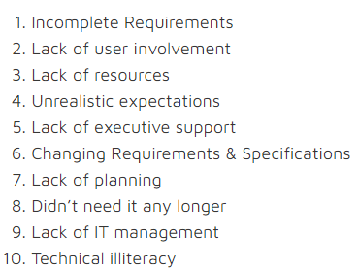
Top Factors in Failed IT Projects
https://www.opendoorerp.com/the-standish-group-report-83-9-of-it-projects-partially-or-completely-fail/

Slide 6
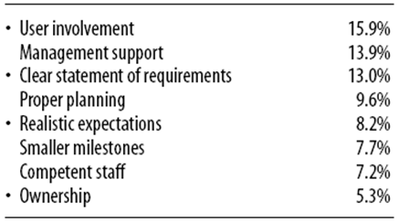
Top Factors in Successful IT Projects
https://www.opendoorerp.com/the-standish-group-report-83-9-of-it-projects-partially-or-completely-fail/

Slide 7
The Problems Fall into Three Main Categories:
Requirements – either poorly organized, poorly expressed, weakly related to stakeholders, changing too rapidly or unnecessary; unrealistic expectations.
Management problems of resources – failure to have enough money, and lack of support or failure to impose proper discipline and planning; many of these arise from poor requirements control.
Politics – which contributes to the first two problems.

Slide 8
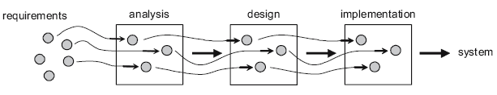
RE: Challenge
40-60% of all defects found in a S/W project can be traced back to error made during Req’s change.
Solution:
Req’s should be monitor CONTINUOUSLY.
CONCENTRATE so much on Req’s.

Slide 9
What is a Requirement?
It may range from a high-level abstract statement of a service or of a system constraint to a detailed mathematical functional specification.
This is inevitable as requirements may serve a dual function:
May be the basis for a bid for a contract - therefore must be open to interpretation;
May be the basis for the contract itself - therefore must be defined in detail;
Both these statements may be called requirements.

Slide 10
Requirements Abstraction
“If a company wishes to let a contract for a large software development project, it must define its needs in a sufficiently abstract way that a solution is not pre-defined.
The requirements must be written so that several contractors can bid for the contract, offering, perhaps, different ways of meeting the client organization’s needs.
Once a contract has been awarded, the contractor must write a system definition (requirement document) for the client in more detail so that the client understands and can validate what the software will do.”

Slide 11
RE: Definitions
Freeman:
A statement of system service or constraints. [Req]
“A process in which “what is to be done” is elicited, modeled, and communicated” [RE].
Ian Sommerville
“The descriptions of the services and constraints are the req’s for the system and the process of finding out, analyzing, documenting and checking these services and constraints is called RE”.
IEEE-610
“A condition or capability needed by a user to solve a problem or achieve an objective” [Req].

Slide 12
RE: Tasks
RE provides the mechanism for understanding:
What the customer wants
Analyzing need
Assessing feasibility
Negotiating a reasonable solution
Specify the solution unambiguously
Validating the specification
Managing the req’s as they are transformed into operational system

Slide 13
RE: Tasks…
Inception
Ask a set of questions that establish …
basic understanding of the problem
the people who want a solution
the nature of the solution that is desired, and
the effectiveness of preliminary communication and collaboration between the customer and the developer
Elicitation
Elicit requirements from all stakeholders
Elaboration
Create an analysis model that identifies data, function and behavioral requirements.
Negotiation
Agree on a deliverable system that is realistic for developers and customers.

Slide 14
RE: Tasks…
Specification
can be any one (or more) of the following:
A written document
A set of models
A formal mathematical representation
A collection of user scenarios (use-cases)
A prototype
Validation
a review mechanism that looks for
errors in content or interpretation
areas where clarification may be required
missing information
inconsistencies (a major problem when large products or systems are engineered)
conflicting or unrealistic (unachievable) requirements.

Slide 15
RE: Process
The process through which the customer, buyers, or users of a S/W system discover, reveal, articulate, and understand their req’s.
The process of recording the req’s.
The process of confirming with the customer or user of the S/W that the specified req’s are valid, correct, and complete.

Slide 16
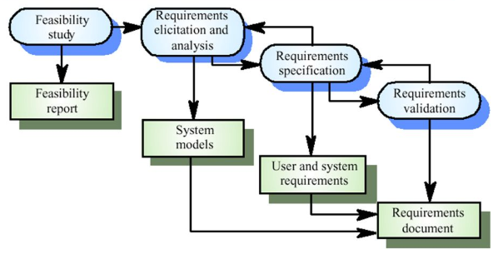
RE: Process…

Slide 17
RE: Process (Spiral View)

Slide 18
Requirements: Main Categories
Needs: capabilities & characteristics required in the S/W system to solve problem.
Wishes: capabilities & characteristics desired in the S/W system to solve problem.
Expectations: capabilities & characteristics expected in the S/W system to solve problem.

Slide 19
Requirement Analyst: Tasks

Slide 20
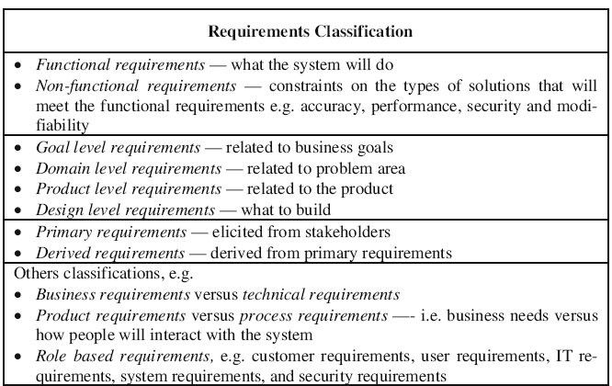

Slide 21
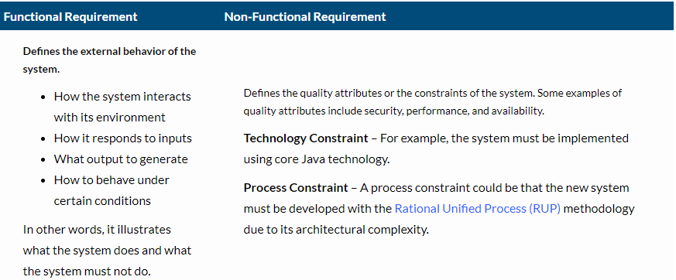
Functional vs. Non-Functional Requirements

Slide 22
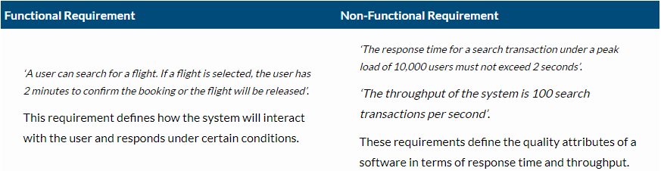
Functional vs. Non-Functional Requirements…
Let us consider an example of an airline reservation system, where users can search and book flight tickets. The Functional and Non-functional requirements for this use case can be defined as:

Slide 23
Functional Requirements: Mentcare System
A user shall be able to search the appointments lists for all clinics.
The system shall generate each day, for each clinic, a list of patients who are expected to attend appointments that day.
Each staff member using the system shall be uniquely identified by his or her 8-digit employee number.

Slide 24
Metrics for Specifying Non-Functional Requirements
Property | Measure
Speed | Processed transactions/second User/event response time Screen refresh time
Size | Mbytes Number of ROM chips
Ease of use | Training time Number of help frames
Reliability | Mean time to failure Probability of unavailability Rate of failure occurrence Availability
Robustness | Time to restart after failure Percentage of events causing failure Probability of data corruption on failure
Portability | Percentage of target dependent statements Number of target systems

Slide 25
User vs. System Requirements
User requirements
Statements in natural language plus diagrams of the services the system provides and its operational constraints. Written for customers.
System requirements
A structured document setting out detailed descriptions of the system’s functions, services and operational constraints. Defines what should be implemented so may be part of a contract between client and contractor.

Slide 26
User vs. System Requirements: Example

Slide 27
User Story
As a <role>, I <want / need> to <do something>
As a teacher, I want to tell all members of my group when new information is available.
A variant of this standard format adds a justification for the action:
As a <role> I <want / need> to <do something> so that <reason>
For example:
As a teacher, I need to be able to report who is attending a class trip so that the school maintains the required health and safety records.

Slide 28
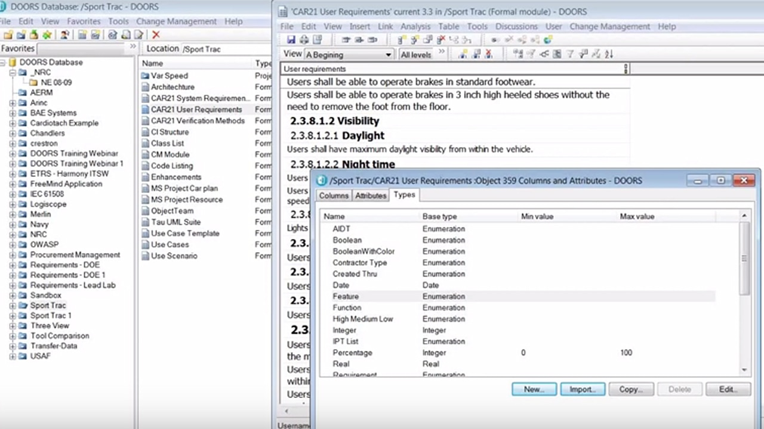
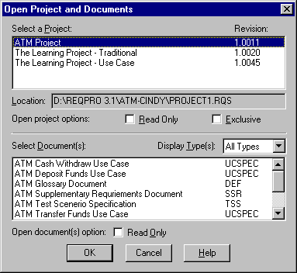
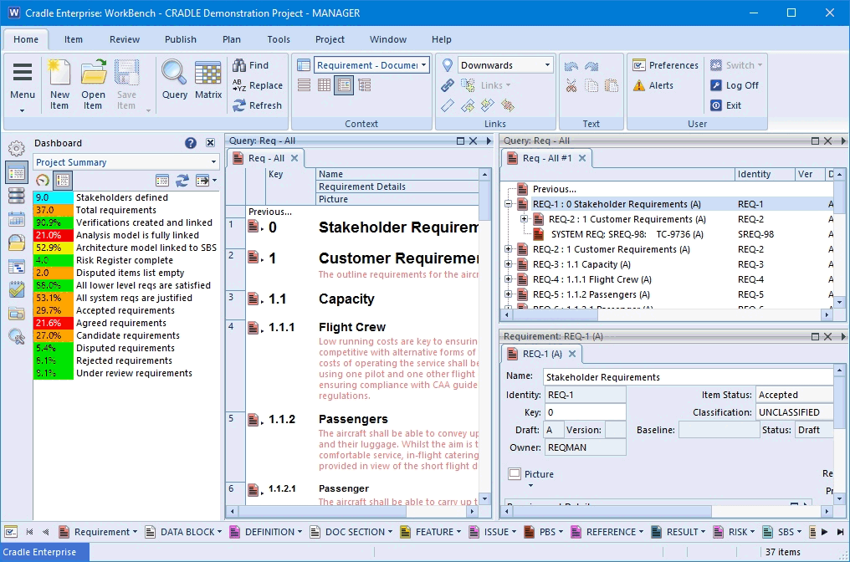
Automated tools for Req’s Management
Rational DOORs
Requisite Pro
Cradle

Slide 29
